Slide 1
Lessons from the Mission Field Transforming Lives Through Medical Outreach
Insights from Missions in Senegal, Madagascar, Angola, and Ivory Coast
Augustin K. Lutakwa

Slide 2
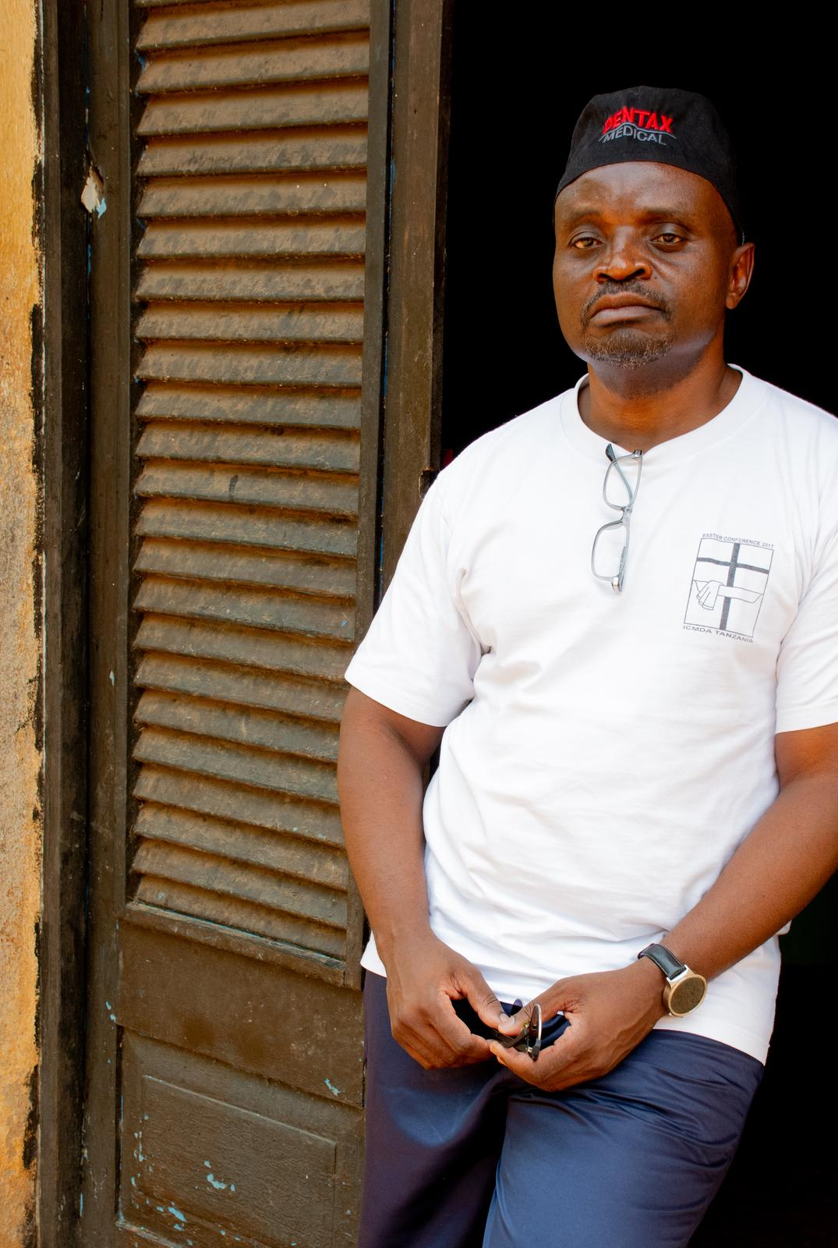
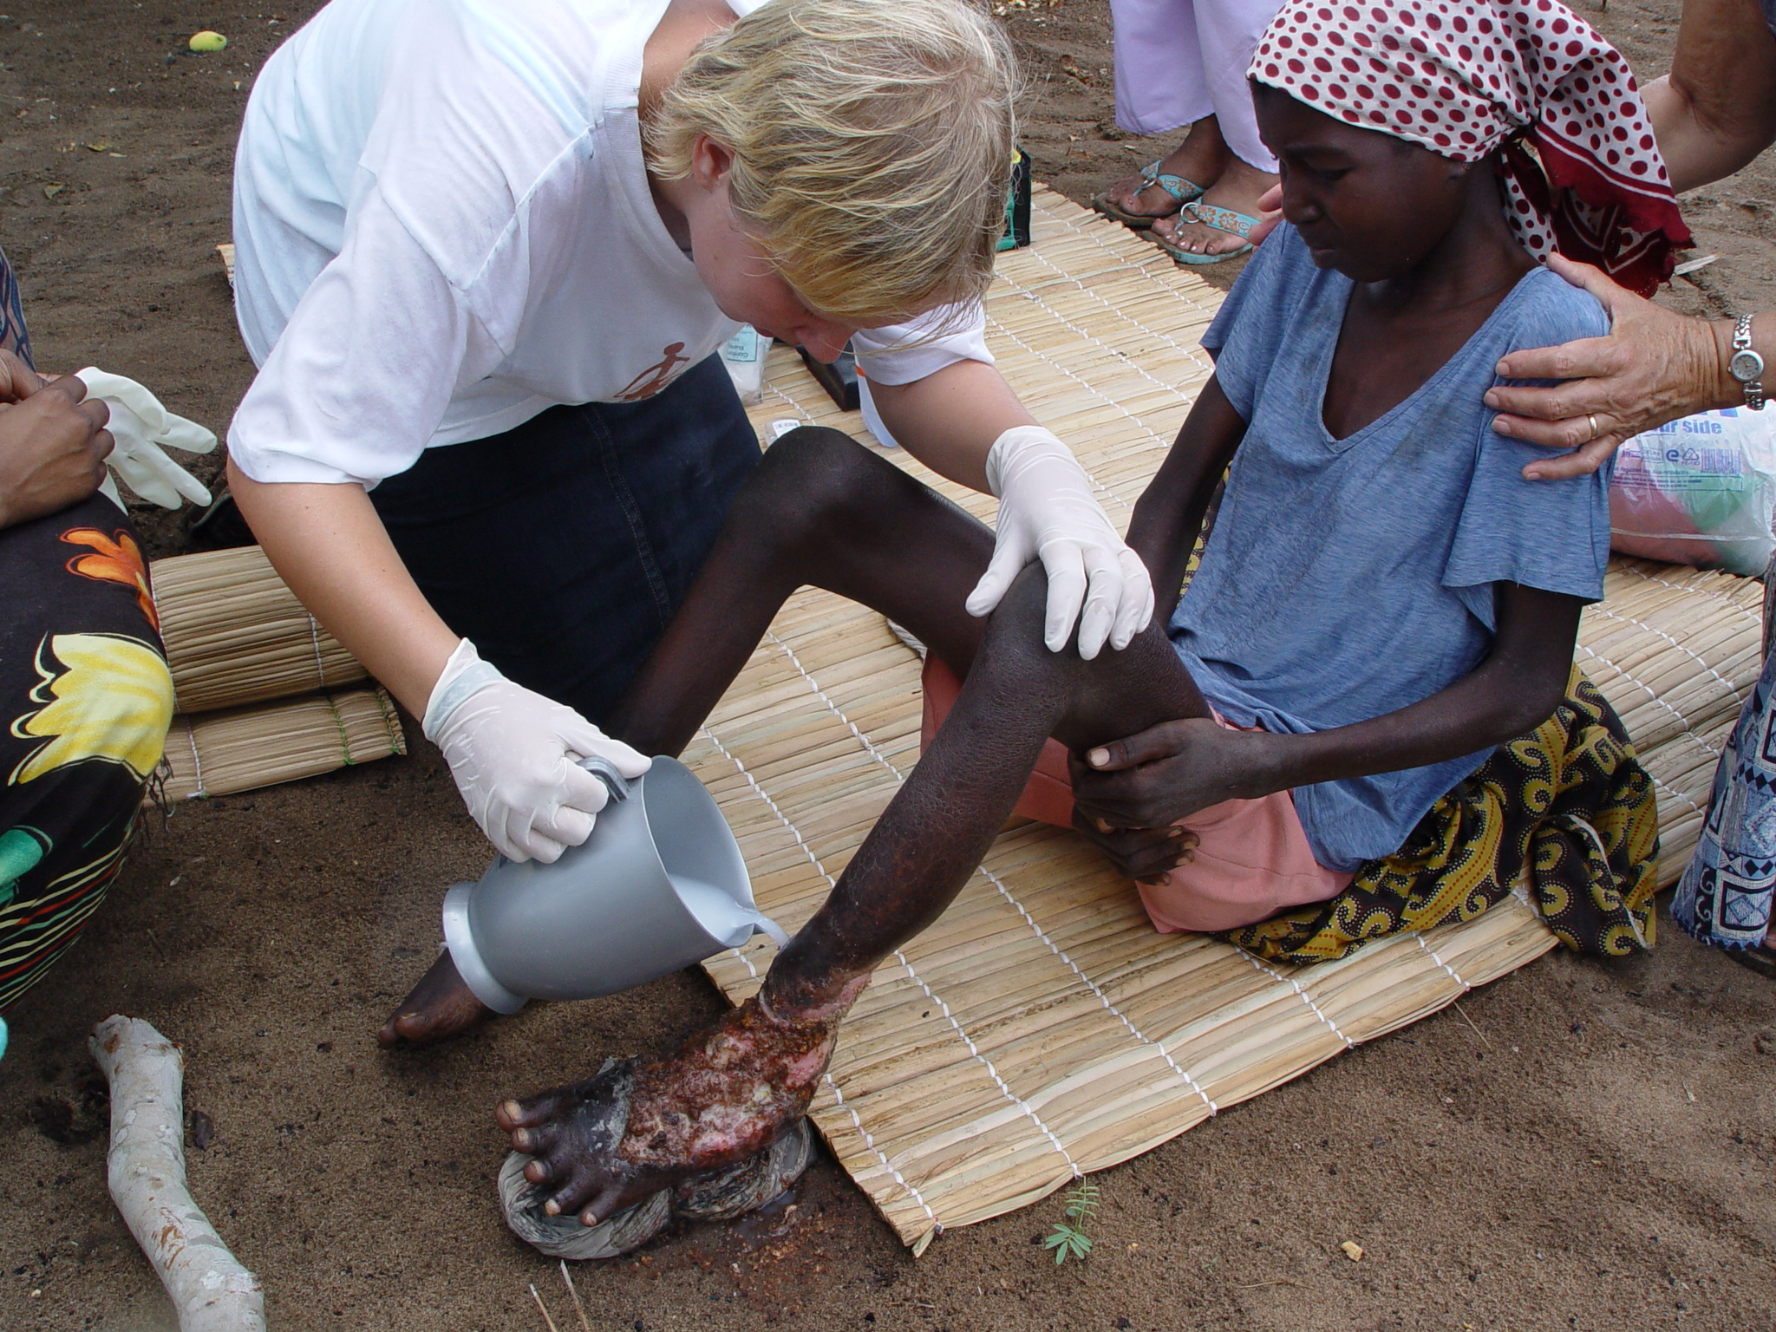
Introduction
Brief introduction:
about myself & my mission work
Zavora Clinic in Mozambique

Slide 3
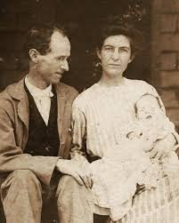
The Heart of Medical Missions
Biblical Foundation:
  Matthew 25:35-40 – "Whatever you did for one of the least of these, you did for me."
  Luke 10:33-37 – The Good Samaritan’s example
Why Medical Missions?
  Addressing spiritual & medical needs
  Role of Christian healthcare professionals in Christ’s ministry
Dr Elwood and Bernice Kijabe hospital

Slide 4
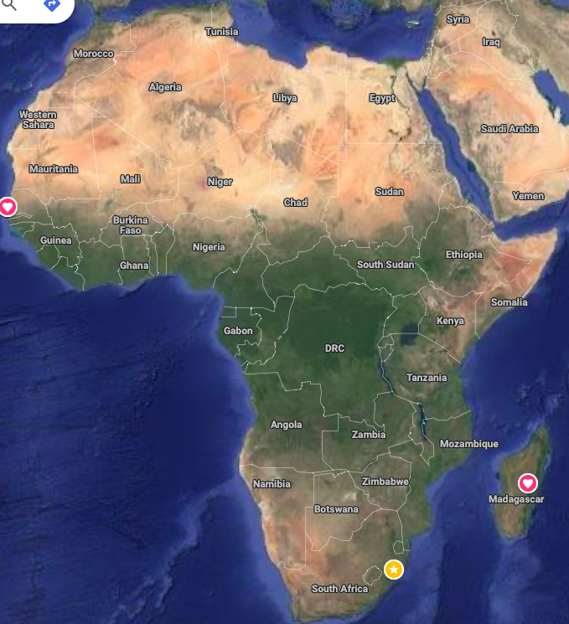
Key Lessons from the Field
Stories & experiences from four countries
Themes:
Faith, perseverance, teamwork

Slide 5
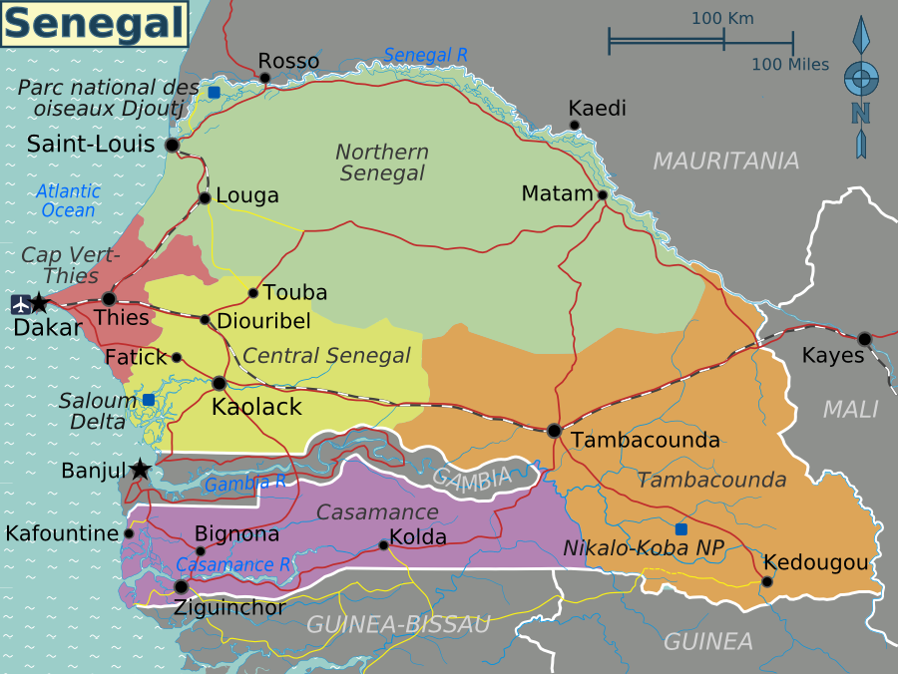
SENEGAL Outreach/Mission
Barthimee Hospital Pictures
Barthimee Hospital Website
Poste de Sante Keru Yakar –Dakar
Post de Sante Keru-Yiiw
Clinique de Galle Kisalle- Dhara

Slide 6
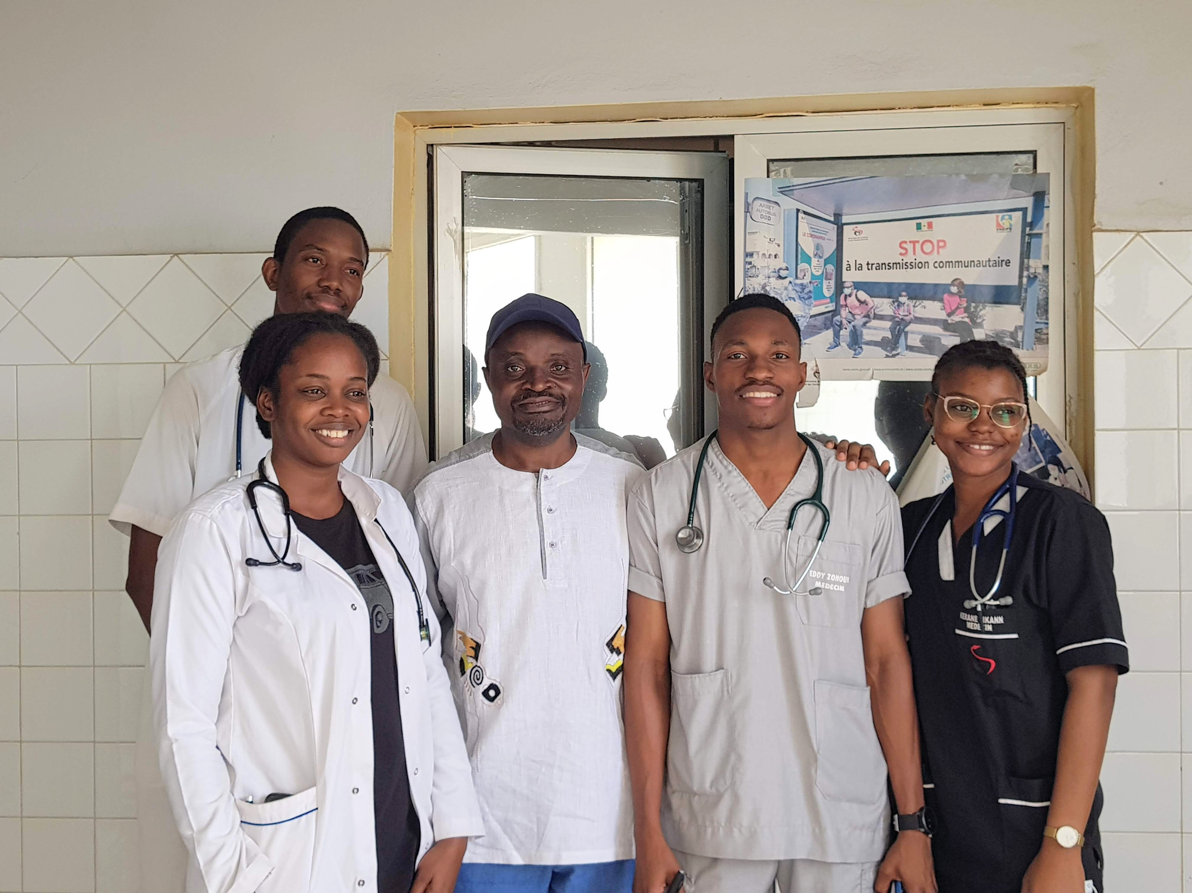
SENEGAL
Inspiring Young Doctors
Challenge:
Many young doctors lack vision
Lesson:
Mission work helps doctors find purpose beyond a career
Example:
Mentoring a young doctor who found his calling

Slide 7
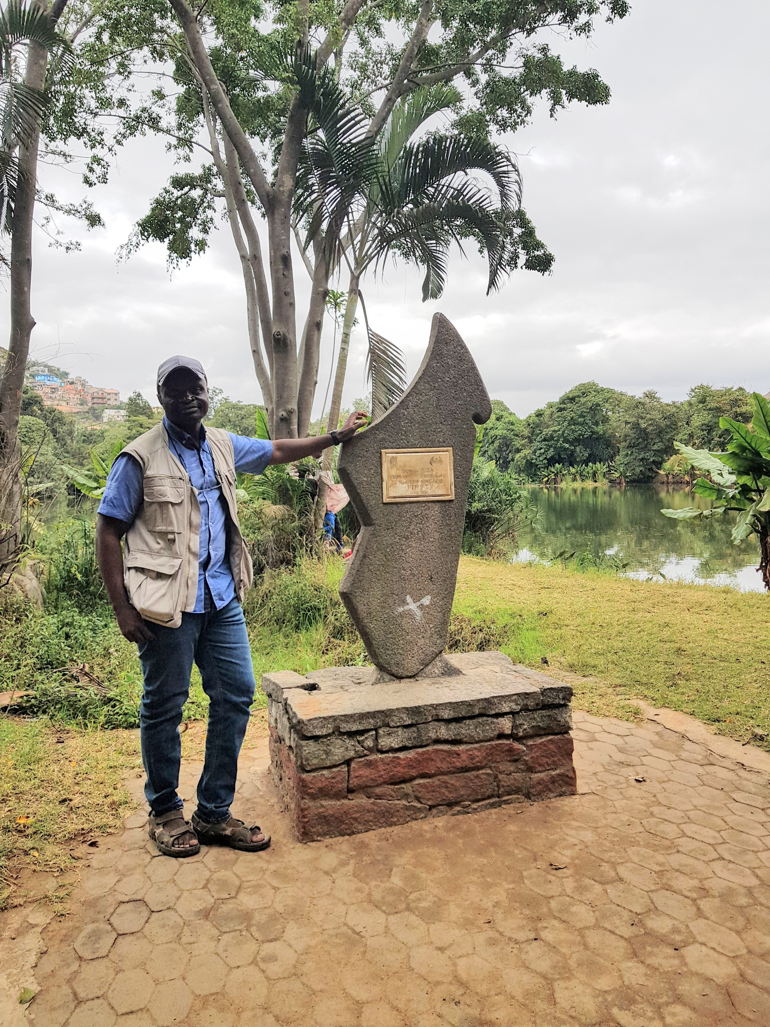
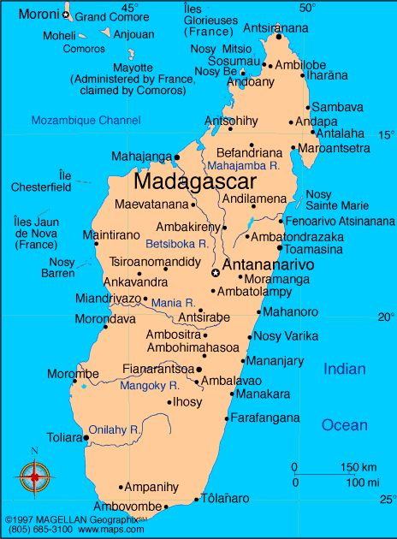


Madagascar

Slide 8
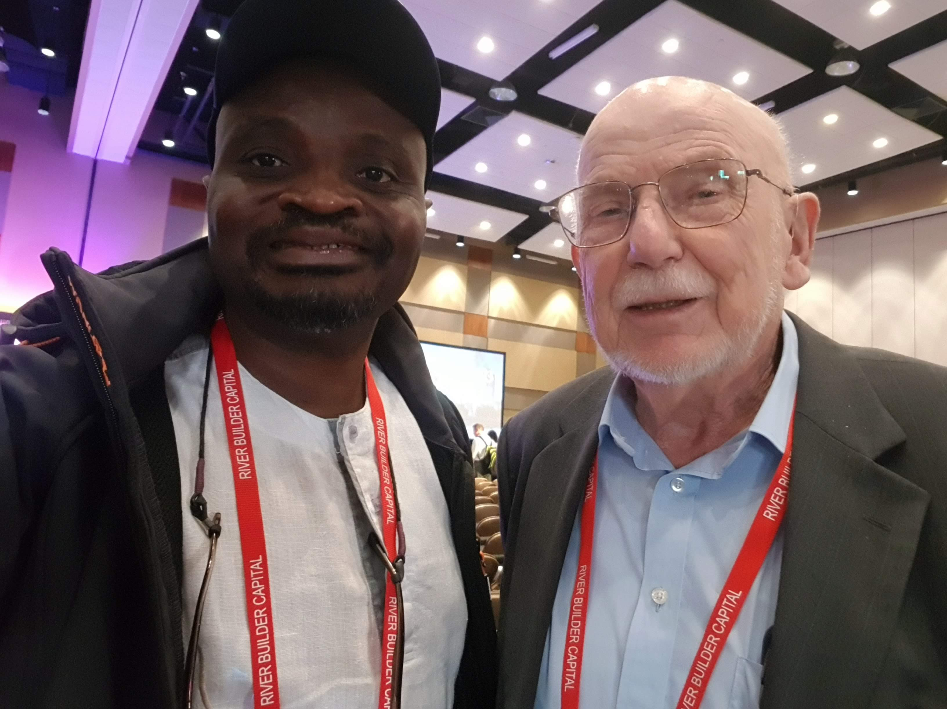
MADAGASCAR—Overcoming Challenges & Trusting God
Limited resources but God’s provision is always enough
Example: Dr. Quanbeck’s Story
  Started with a small vision to run a Christian hospital
  Entrusted with government facilities due to excellence
  Today: SALFA runs 50+ self-sustaining health centers
  Lesson: "Be faithful in little, and God will entrust you with more."
Links:
SALFA
Antananarivo
Antsirabe
Salfa Ivory Atsimo(Fionarantsoa)

Slide 9
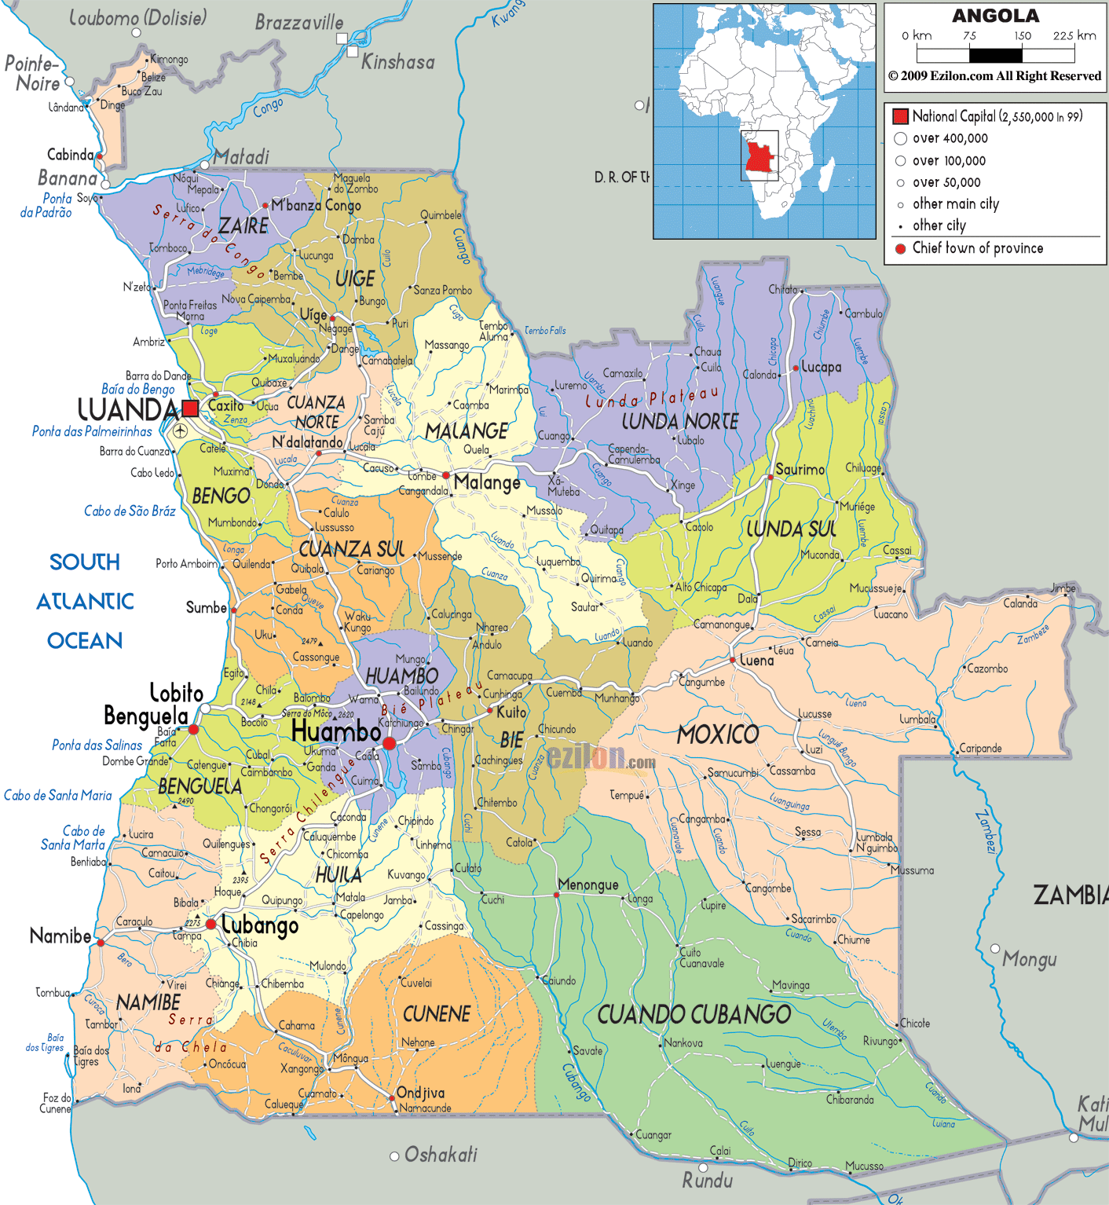
ANGOLA
Cavango Clinic
CEML (Centre Evangelico de Medicina do Lubango)
Hospital Mama Muxima Toco
Augustino Neto Central Hospital
Hospital Olga Chaves:

Slide 10
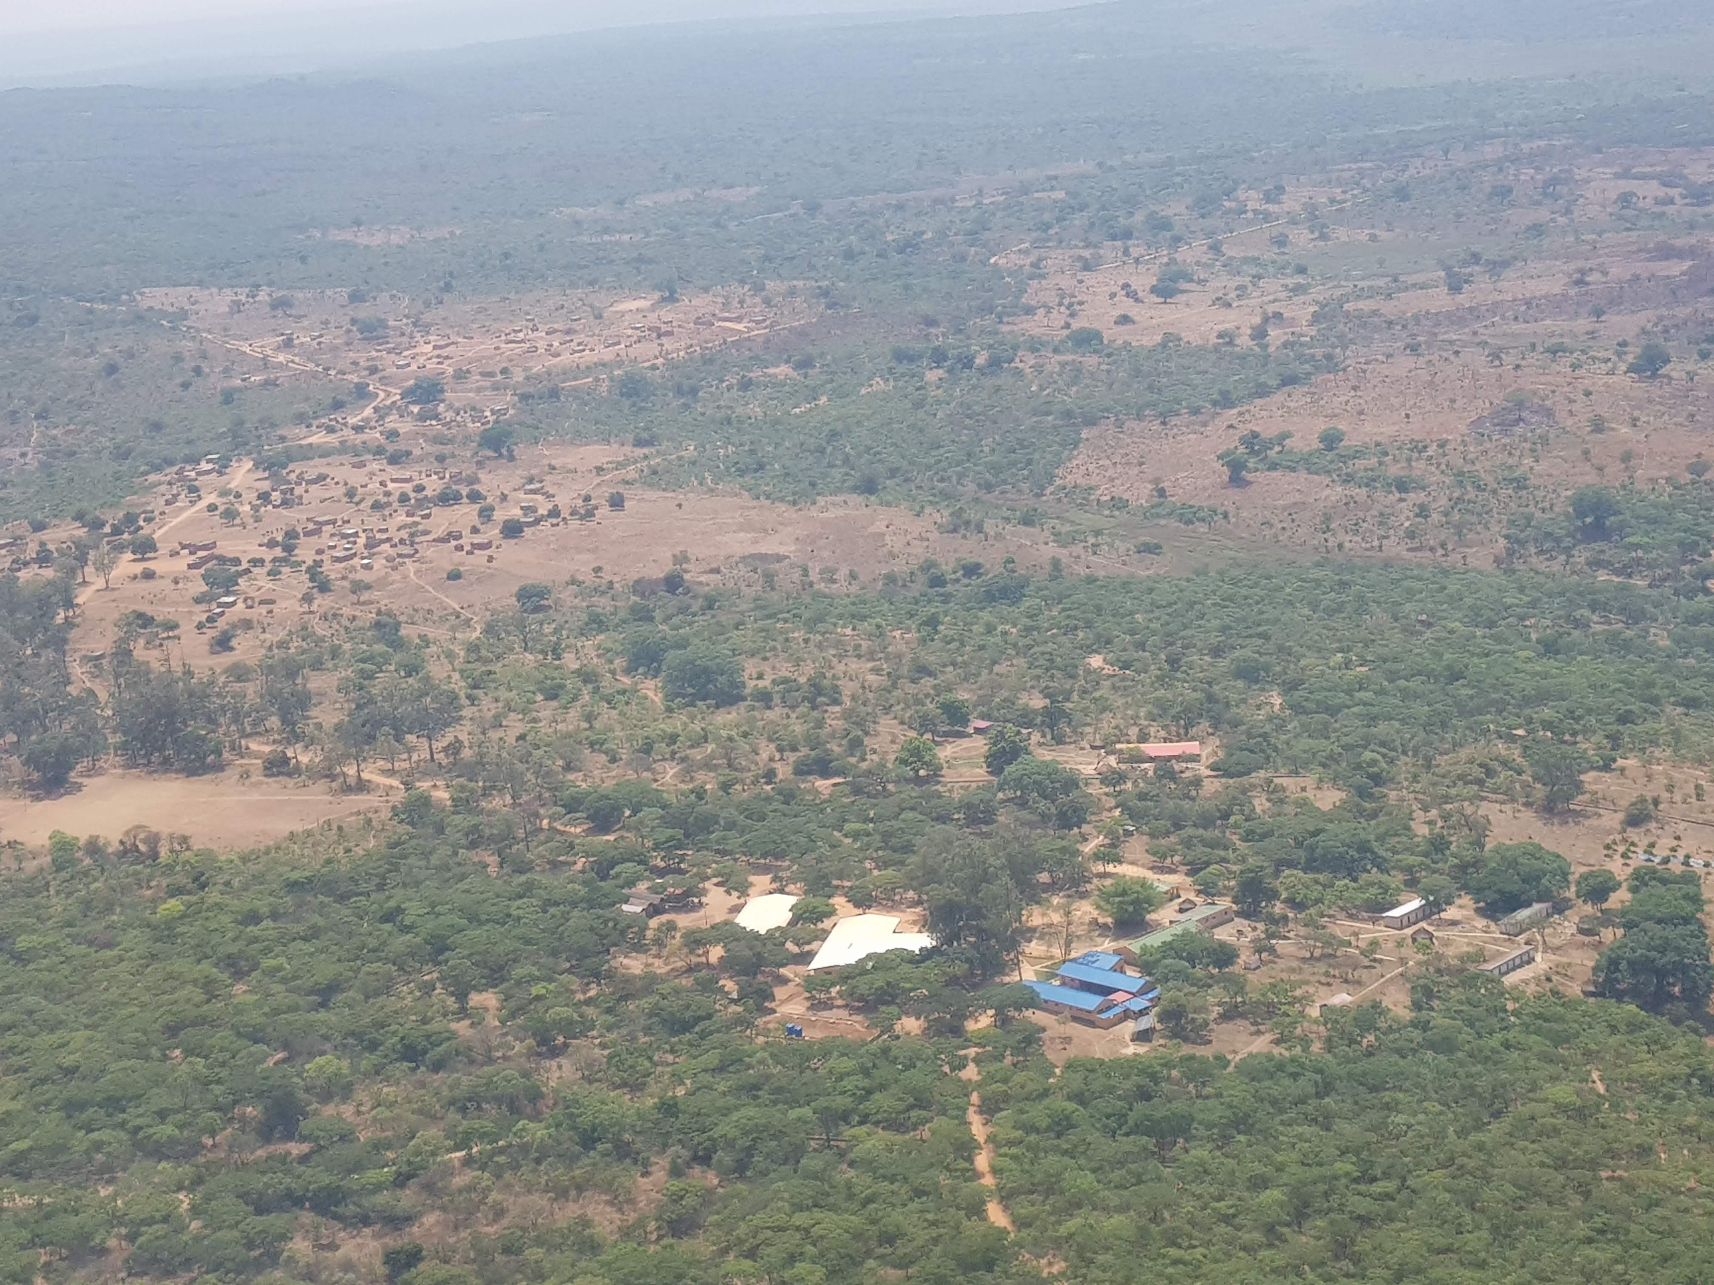
Angola – Challenges in Remote Areas
Minimal supplies, limited staff, remote locations
Lesson: Adaptability, creativity, training locals
Example: Working under extreme conditions

Slide 11
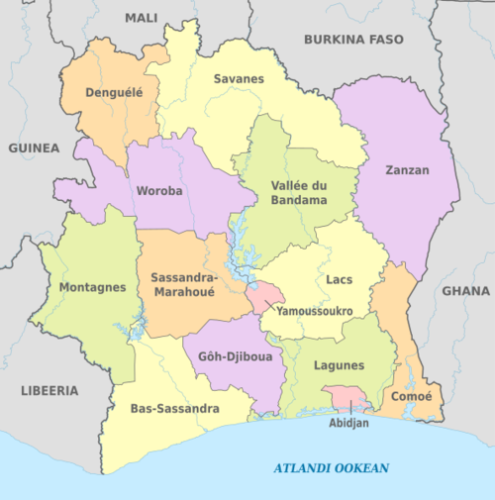
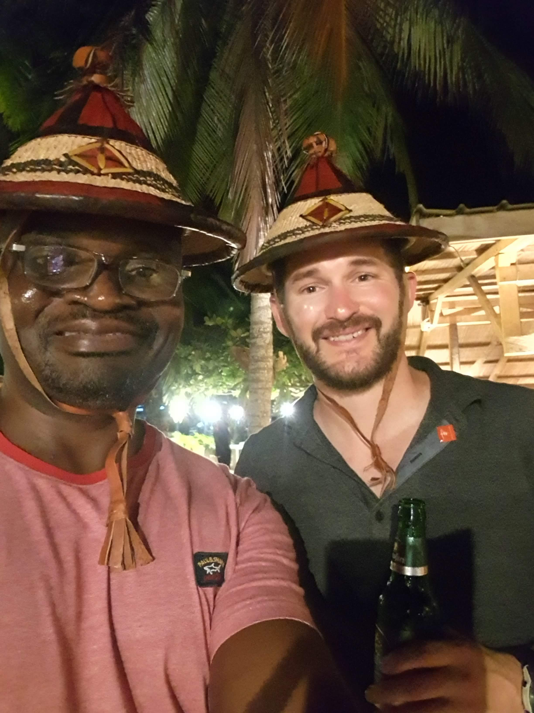
IVORY COAST
Ivory Coast

Slide 12
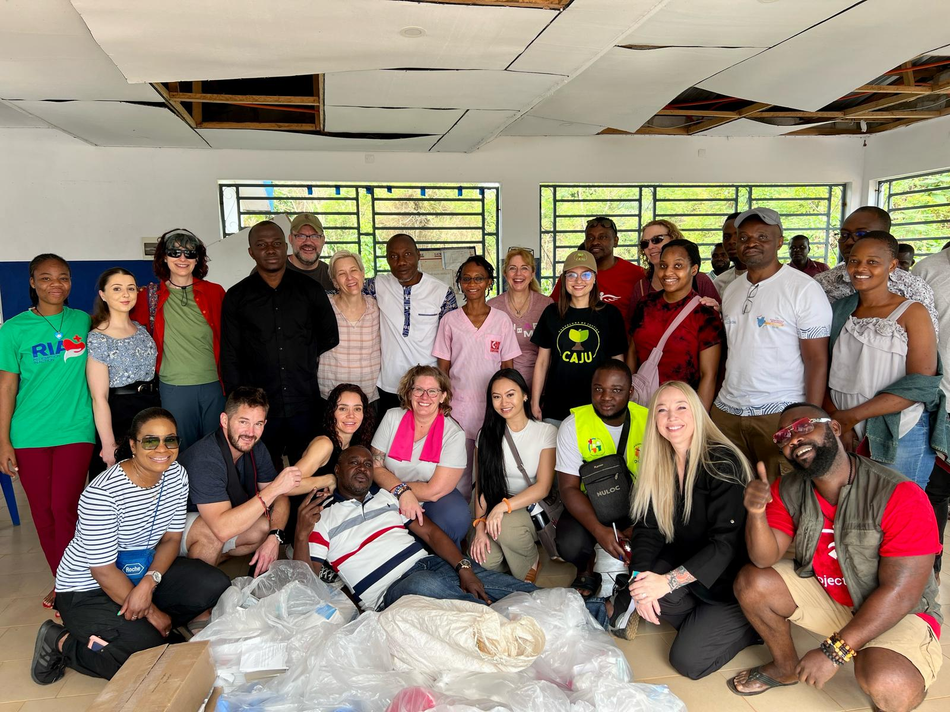
Ivory Coast
– Mission as Teamwork
Mission involves three key groups:
  Those who go – Doctors, nurses, field workers
  Those who support – Donors, logistics teams
  Those who pray – Spiritual warriors sustaining the mission
Lesson: A mission succeeds when all three groups work together

Slide 13
Why Medical Missions
Mission Goal:
No one should be left behind, regardless of geography or resources
Commitment to Global Healthcare:
  Providing quality care to underserved communities
  Supporting rather than replacing local healthcare infrastructure
  Collaboration with local professionals for sustainability
Message: We are a global family—let’s act like it!

Slide 15
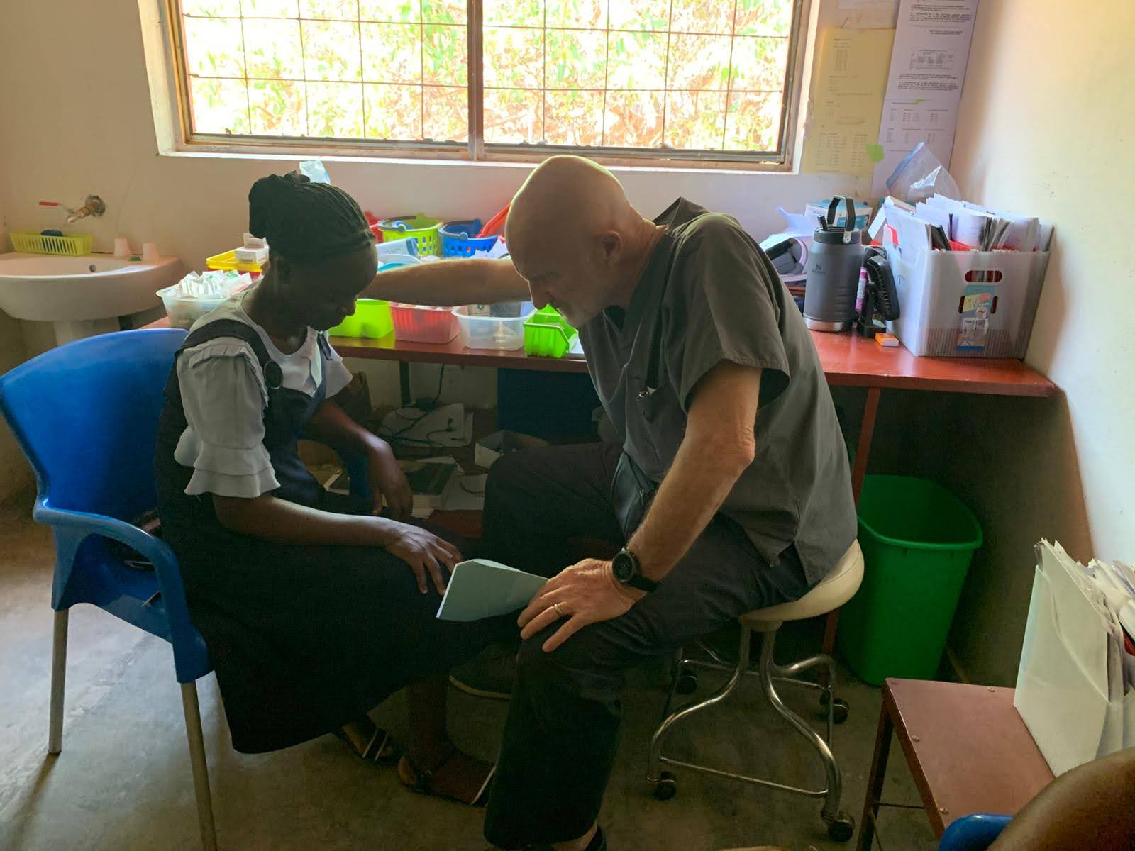
Challenges & Needs in Medical Missions
The Reality on the Ground:
  Shortage of doctors, lack of resources, financial constraints
How Can We Overcome These Challenges?
  More volunteers, financial support, medical supply donations, and prayer

Slide 16

Call to Action - How You Can Get Involved?
Go – Join a mission trip, serve where needed
Give – Sponsor a project, donate supplies, support financially
Pray – Keep missions and healthcare workers in prayer
Challenge: Take one step today to be part of this mission

Slide 17

Q&A
Discussion
Prayer for guidance in serving others
Thank you Rachel & Victor
(Ngithume Nkosi)
All the Unnamed Angels-Financial support!
To God All the Glory!

