Slide 1
Management of Diarrhea and Dehydration in SAM
Dr Ssegujja Boniface
Pediatrician - BLH

Slide 2
Objective
Signs and symptoms
Classification of diarrhea and dehydration
Principles of treatment of diarrhea and dehydration
Treatment of dehydration and hypovolemic shock
Monitoring
ReSoMal preparation

Slide 3
Background
Globally malnutrition is the 3rd most important cause of mortality and morbidity in children under 5 years of age.
In 2024, 42.8 million children were estimated to be wasted, and over 150.2 million were stunted (JME UNICEF-WHO-WB)
In Botswana, 3.2% of under 5 are underweight and 19.8% are stunted.
Malnutrition magnifies the effect of all childhood diseases.
Notes:
JME – Joint Child Malnutrition Estimates

Slide 4
Definition - SAM
MUAC – less than 11.5cm
WFL or WFH Z scores – less than 3SD
Edema – presence of bilateral nutritional pitting edema
Admission criteria: presence of danger signs, severe edema (3+), poor appetite (failed appetite test), medical complications, failure to gain weight/improve clinically in outpatient care.

Slide 5
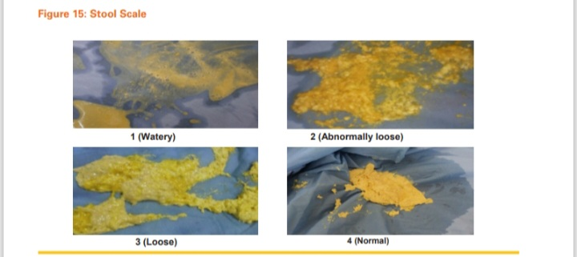
Definition - Diarrhea
Frequent bowel movements: more than 3-4 loose or watery stools per day
Increased stool volume: larger than normal amount of stool.

Slide 6
Diarrhea and dehydration in SAM
Diarrhoea /Dehydration is the single most common cause of death in malnutrition
Difficulty to diagnose dehydration and assess it′s severity:
Clinical signs associated with dehydration in a normal child such as sunken eyes, dry mucus membranes, loss of skin elasticity / turgor etc may occur and be present in a malnourished child who is not dehydrated.
The physiological changes due to malnutrition complicates the choice and volume of fluid to be given.

Slide 7
Signs and symptoms of dehydration:
SAM – (Non-oedematous):
Children with wasting malnutrition have skin folds that hang loosely due to loss of subcutaneous tissues and reduction in muscle mass. This superficially gives them a dehydrated look even when they may not be dehydrated.
Skin pinch test in wasted malnourished child is therefore not useful to identify dehydration and should not be carried out.
Eyes of wasted children may appear sunken due to loss orbital subcutaneous tissue
Wasted malnourished children may also not produce tears on crying due to atrophy of lachrymal glands.

Slide 8
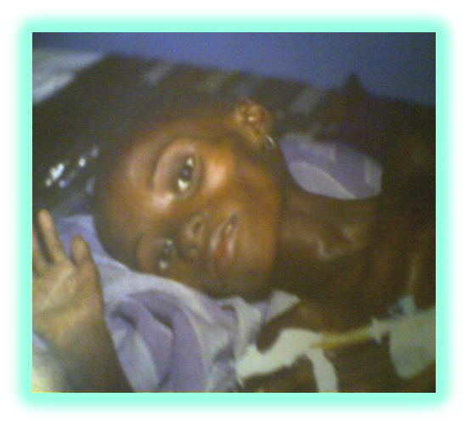
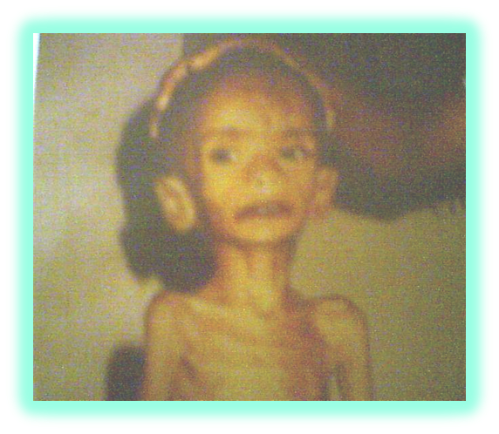

Are these children dehydrated?

Slide 9
Signs and symptoms of dehydration
SAM – (Oedematous):
Children with oedematous malnutrition have an increased total body fluid due to excessively retained sodium and water. They are technically over-hydrated although they may be frequently hypovolaemic. The diagnosis of dehydration in oedematous malnutrition is also based on history of fluid losses as is the case with wasted children.

Slide 10
Classification of diarrhea and dehydration in SAM
Diarrhea without dehydration:
This is a malnourished child with history of few semi formed, mucoid stools who appears clinically well, is alert and accepting orally . There is no weight loss

Slide 11
Classification of diarrhea and dehydration in SAM
2. Diarrhea with dehydration:
This is a malnourished child with history of 3 or more watery formless stools and/or significant vomiting who appears clinical unwell, is weak, lethargic, inactive and refusing feeds orally. There is weight loss of about 3-5%

Slide 12
Classification of diarrhea and dehydration in SAM
3. Diarrhea with hypovolemic shock:
This is a malnourished child with history significant watery stools and /or vomiting who appears clinically unwell and is unconscious. There is weight loss of about 8-10%. Features that define shock in malnutrition are;
Extreme lethargy or unconsciousness And
Cold peripheries, And
Either fast, weak pulse or slow capillary refill time (CRT>3sec).
Hypotension
Acidotic breathing, Paralytic ileus, inability to pass urine > 6 hours support the diagnosis of hypovolemic shock.

Slide 13
General principles of treatment of dehydration:
Always use oral rehydration solution to treat dehydration
IV infusions are almost never required. IV infusions are only indicated in shock.
Rehydration should be carried out over extended period, 10-12hrs as against 4-6hrs as is a norm in normal child.
The choice of rehydration solutions, oral or IV is determined by Na⁺ and K⁺ concentration in them. Always use rehydration solutions with low Na⁺ and high K⁺ concentration with Dextrose water
Always target patient′s weight while rehydrating
Malnourished children with dehydration should be monitored meticulously during re-hydration to prevent over hydration (every 10-20 min or 1 hourly)
Continue breast feeding in breastfeed children

Slide 14
General principles of treatment of dehydration:
Before rehydration:
Weigh and record the patient’s weight
Mark the edge of the liver
Record the RR, HR, CRT, and Heart sounds
Calculate target weight

Slide 15
General principles of treatment of dehydration:
Target patients' weight for rehydration
When pre-diarrhoeal weight is not known and recorded, For newly admitted child, it is extremely difficult to judge the amount of fluid loss as all the clinical signs are unreliable. Because of the narrow therapeutic window and the danger of going from under-hydration to over-hydration, the estimated weight deficit should be conservative.
In practice, the weight loss is generally 1% to 3% of body weight in most children and in a few up to 5%. A weight gain of up to 5% of body weight with rehydration in a the truly dehydrated child will show dramatic clinical improvement
Do not attempt to increase body weight by more than 5% in conscious children (Malnourished child not in shock ). The volume of fluids to be give can be determined from RTU 5% weight gain chart

Slide 16
Diarrhea without dehydration
Malnourished child may normally pass 2-3 semi-formed, mucoid stools/ day with occasional vomiting. This is normal and does not require to be treated with ReSoMal, if the child appears stable , is feeding well and not losing weight.
Give ReSoMal in small volumes at 5-10ml/kg per loose stool.

Slide 17
Diarrhea with dehydration
Give ReSoMal at 10ml/kg/hour for the first 2 hours orally or by NG tube and then adjust according to the weight changes.
If there is weight gain and clinical improvement, continue at 5-10ml/kg/hour but do not exceed target weight.
Alternate ReSoMal with F75 for the next 4-10 hours. Use same volume of F75 as for ReSoMal
If weight gain but clinically worse, stop rehydration.
Monitor hourly:
Weight change
Signs improvement ; Pulse ,CRT, Respirations
Signs over hydration ; Liver size ,gallop, JVP
Notes:
As the child is rehydrated, RR and HR should decrease to a normal range and
child should begin to pass urine
Continued fast breathing and rapid HR suggests overhydration or co-existing infection.
Clinical improvement / target weight reached – stop Resomal and continue 2 hourly F75.

Slide 18
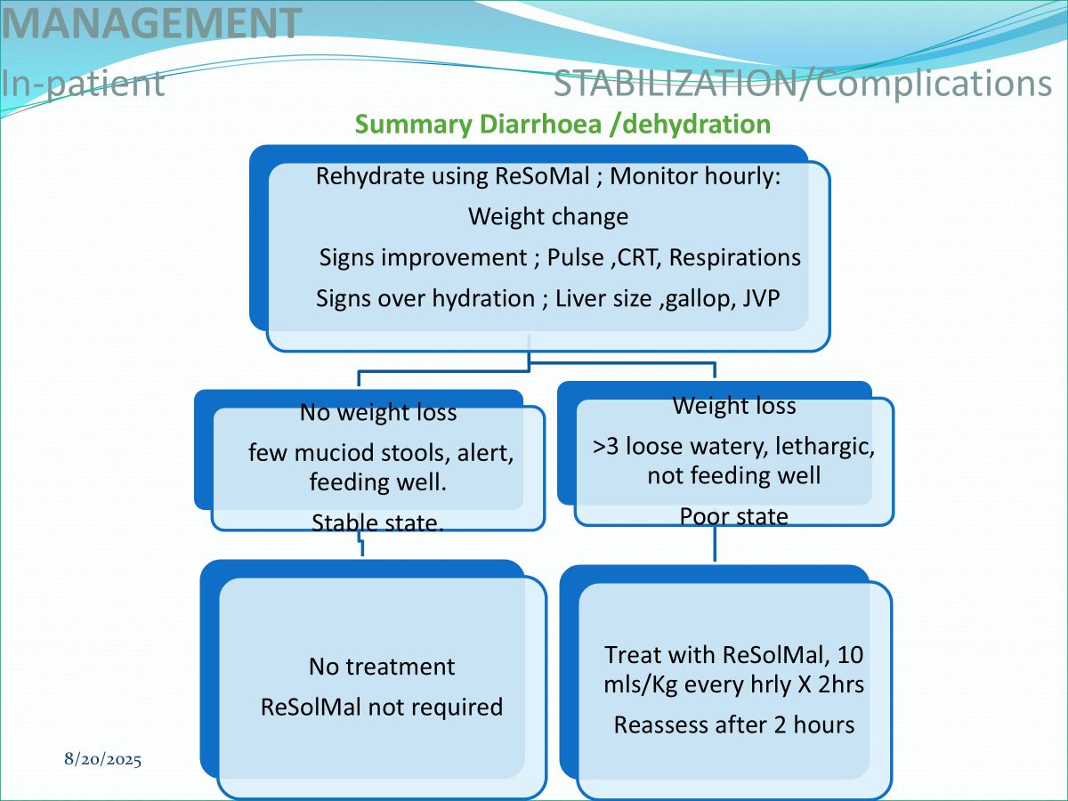
Summary

Slide 19
Diarrhea with shock
Give oxygen
Give antibiotics
Give IVF at 15ml/kg over 1 hour
Use: ½ DD or Ringer’s lactate with 5% dextrose or half NS with 5% dextrose
Reassess after bolus, If improving – give 2nd 15ml/kg over 1 hour and assess
Measure and record pulse and RR every 30 mins to avoid congestive heart failure
Once there is clinical improvement, stop IVF. Switch to oral rehydration with ReSoMal over 10 hours 5-10ml/kg/hr alternating with F75

Slide 20
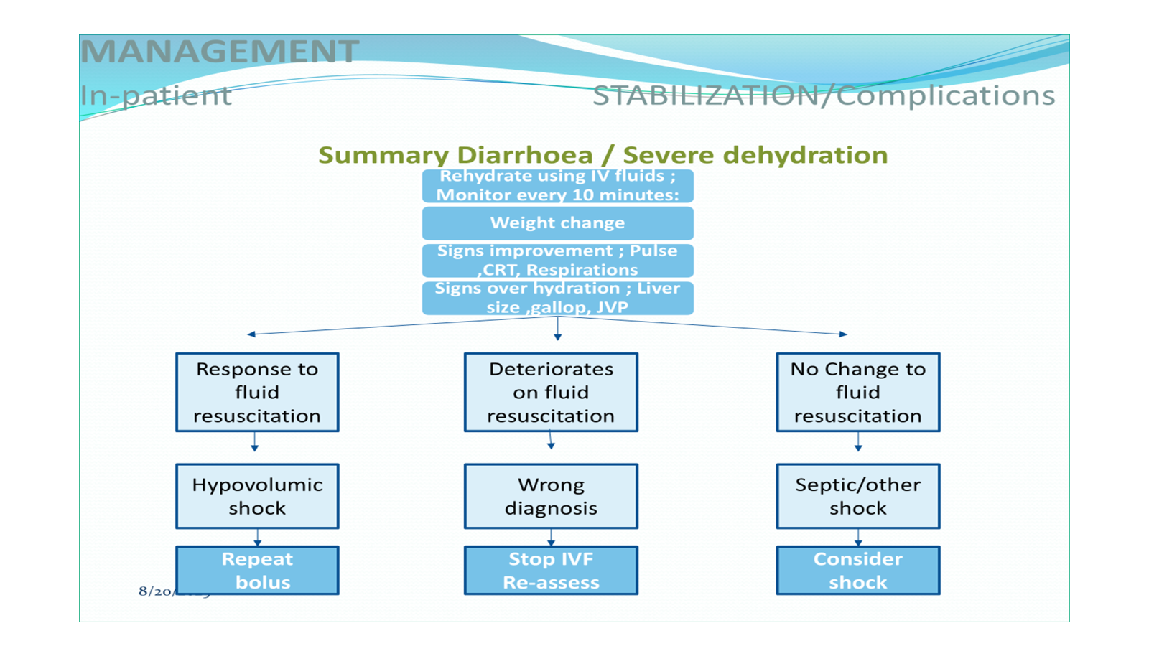

Slide 21
Monitoring
Check for & identify signs of over hydration & heart failure. The signs of over hydration are:
Increasing weight beyond target weight
Increasing heart rate (>20 beats per minute), engorged neck veins, appearance of gallop
Increasing respiratory rate (>5 breaths per minute), development of grunting , basal crepitations on auscultation of lungs
Increasing liver size ,tenderness over liver.
Any signs of clinical deterioration, stop IVF and reassess.
Consider a blood transfusion of 10ml/kg over 3-6 hours if there is no improvement

Slide 22
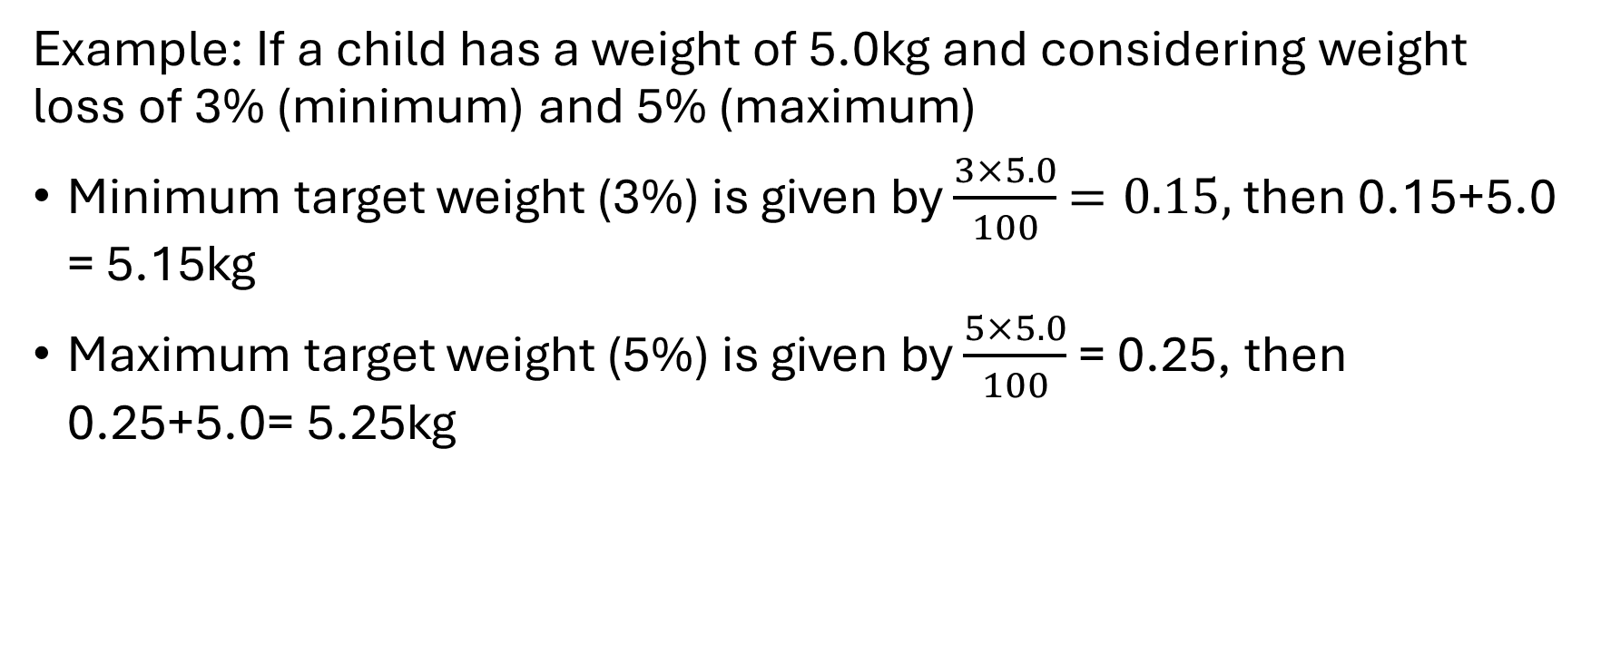
How to calculate target weight
Example: If a child has a weight of 5.0kg and considering weight loss of 3% (minimum) and 5% (maximum)
Minimum target weight (3%) is given by $\frac{3×5.0}{100}$ $=0.15,$ then 0.15+5.0 = 5.15kg
Maximum target weight (5%) is given by $\frac{5×5.0}{100}$ = 0.25, then 0.25+5.0= 5.25kg
Notes:
When rehydrating ensure the target weight is not more than 5% or less than 3%

Slide 23
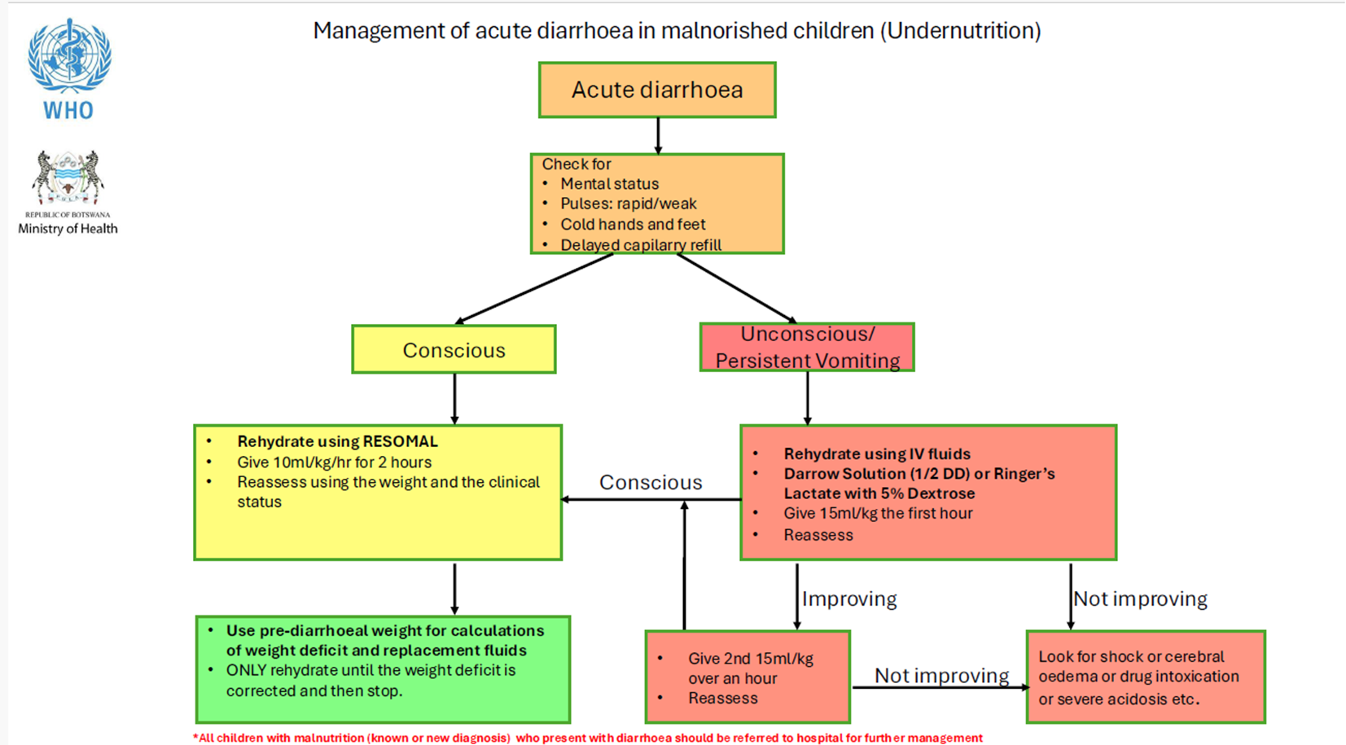

Slide 24
ReSoMal
Rehydration solution designed for children with SAM
Lower osmolarity: ReSoMal has a lower concentration of electrolytes compared to standard ORS
Reduced sodium content: Helps prevent excessive sodium intake which can be problematic in children with SAM
Increased potassium content: Helps replenish potassium stores, which are often depleted in malnourished children.

Slide 25
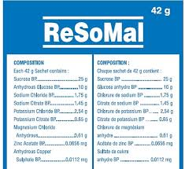
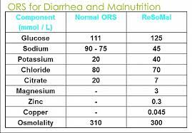
Comparison between ReSoMal and standard ORS

Slide 26
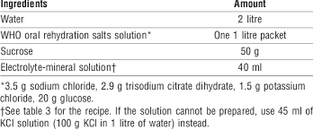
Making ReSoMal from standard ORS

Slide 27
THANK YOU
.

